Slide 1



Multimodal transformer for
affect analysis in
human-virtual agent dyadic interactions
Senorita Rodricks
Advisors: Chirag Bhuvaneshwara, Prof. Dr. Dimitra Tsovaltzi
Reviewers: Prof. Dr. Antonio Kruger, Dr. Patrick Gebhard
Notes:
using technology to understand and analyze emotions in two entities who are interacting.
Automate affect analysis to integrate with virtual agent with interacting with a human to generate better adaptive responses for effective interactions.

Slide 2
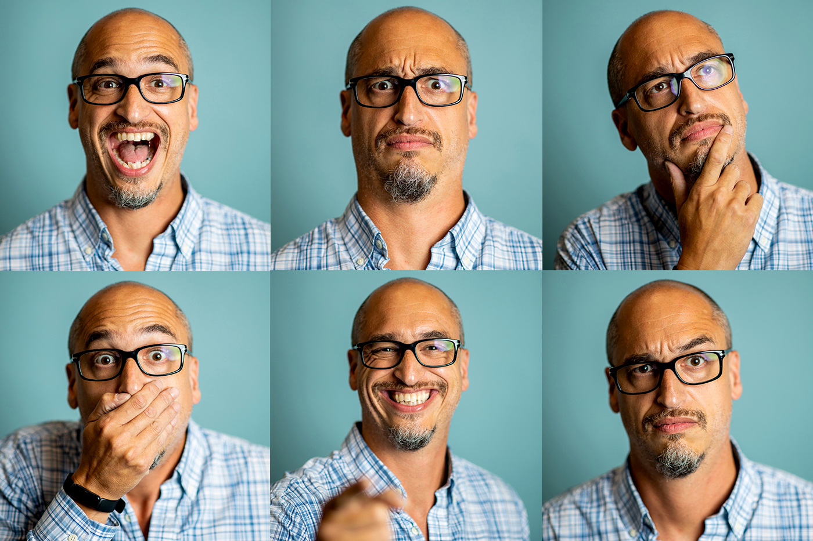
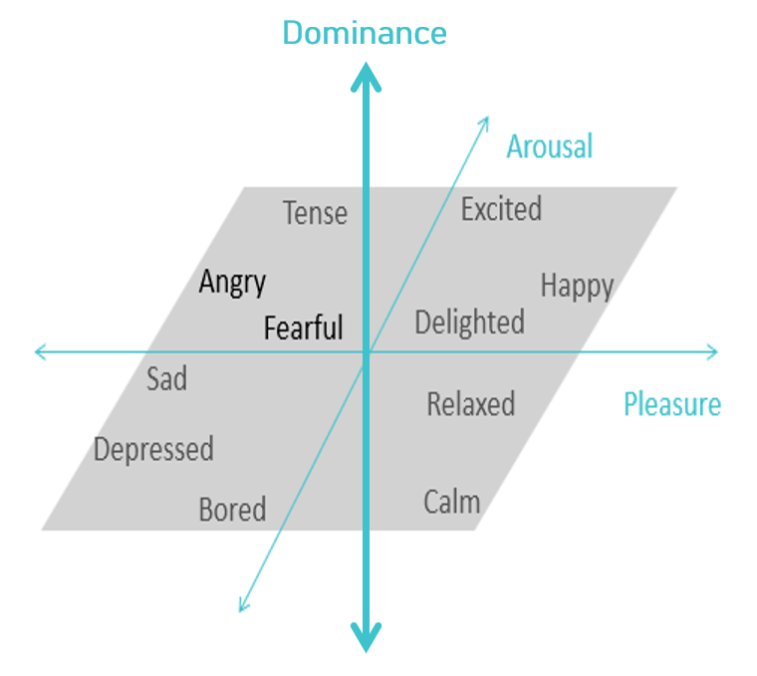
Motivation for thesis Implementation Study Results Conclusion
Definitions Problem Statement Related Work
PAD Model
Albert Mehrabian, James Russel, Basic dimensions for a general psychological theory, 1980
Notes:
Dive into Motivation for thesis.
Img shows emotions can be Understood using socials.
We want a system that encapsulates every emotion, therefore PAD model.
P-degree of pleasantness or unpleasantness an individual
A-intensity of excitement
D-individual’s perception of control over their environment

Slide 3
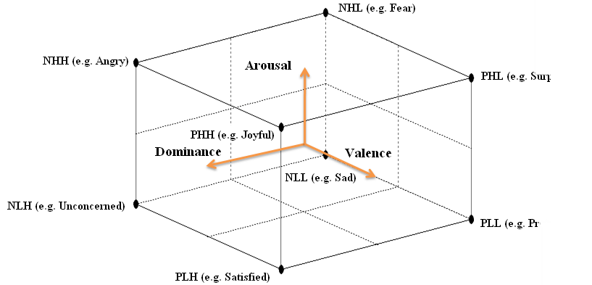
Motivation for thesis Implementation Study Results Conclusion
Definitions Problem Statement Related Work
1
.
.
.
.
.
.
.
-1
1 . . . . . . . . . -1
1 . . . . . . . . . -1
PAD Model
Mehrabian, Albert, Basic dimensions for a general psychological theory, 1980
Notes:
3 independent dimensions visualization

Slide 4
Motivation for thesis Implementation Study Results Conclusion
Definitions Problem Statement Related Work
Predict PAD
Previous emphasis on Pleasure and Arousal prediction only [1]
1
Automate Affect Analysis
Real-time prediction without human intervention. Non-verbal cues are ignored [4]
2
Multimodal architecture
Input data – HRV [2], EEG [3], Video [5], etc., prioritizing non-intrusive data sources
3
[1] Sebastian Handrich, Simultaneous Prediction of Valence/Arousal and Emotions on AffectNet, Aff-Wild and AFEW-VA, 2020
[2] Juan Vazquez-Rodriguez, TRANSFORMER-BASED SELF-SUPERVISED LEARNING FOR EMOTION RECOGNITION, 2022
[3] Viktor Rozgić, ROBUST EEG EMOTION CLASSIFICATION USING SEGMENT LEVEL DECISION FUSION, 2013
[4] Joost Broekens, In defense of dominance: PAD usage in computational representations of affect, 2012
[5] Diana Arellano1 , Francisco J. Perales2 , and Javier Varona , Mood and its Mapping onto Facial Expressions, 2014
Notes:
D was ignored due to subjective and complex nature of Dominance, diff definitions. Good differentiator and needs to be considered
Real-time prediction without human intervention. Non-verbal social signals in prev work, non-intrusive for natural interactions
Single source captures only a specific aspect of the emotional spectrum. (Video-facial expressions)(HRV-physiological reponses).

Slide 5
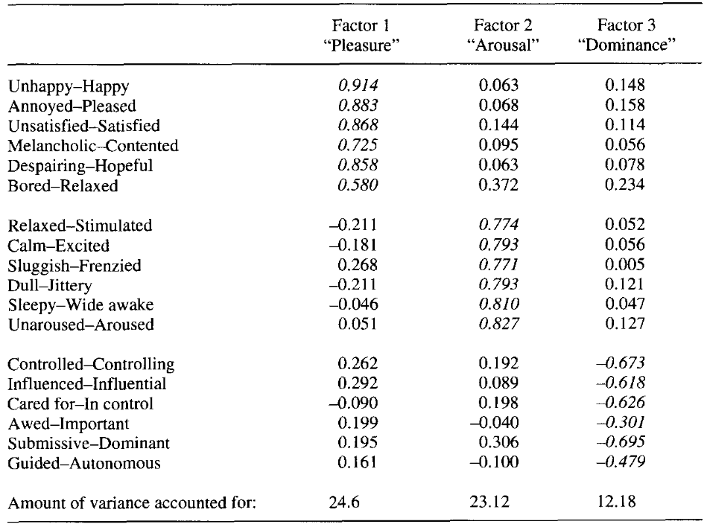
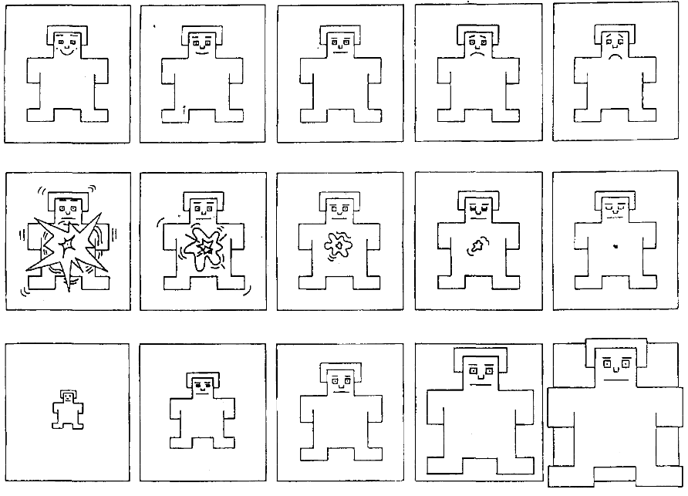
Motivation for thesis Implementation Study Results Conclusion
Definitions Problem Statement Related Work
Automate
Affect Analysis
Predict PAD
Semantic Differential Scale (SDS)^{[1]}
Self-Assessment Manikin (SAM)^{[2]}
[1] Margaret MBradley andPeter J Lang. Measuring emotion: the self-assessment manikin and the semantic differential, 1994
[2] Joost Broekens, Anne Pronker Real time labeling of affect in music using the affectbutton, 2010
Notes:
We use questionnaires like SDS and SAM that represent PAD values which have to be marked by the participant after the experiment.
Rely on self-reporting leading to inaccuracies, as participants asses emotional state after the whole experiment instead of real time. Emotions are dynamic

Slide 6
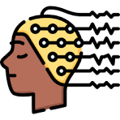




Motivation for thesis Implementation Study Results Conclusion
Definitions Problem Statement Related Work
Automate
Affect Analysis
Predict PAD
Emotion Prediction
Pleasure
Arousal
Dominance
EEG
Video
Fear classification
Text
Audio
Action recognition
ECG
Luca Romeo, Andrea Cavallo, Lucia Pepa, et al. Multiple instance learning for emotion recognition using physiological signals. 2019
Juhee Kim, et al. Prediction of the Emotion Responses to Poster Designs based on Graphical Features: A Machine learning-driven Approach, 2020
Jadisha Cornejo and Helio Pedrini Bimodal emotion recognition based on audio and facial parts using deep convolutional neural networks, 2019
Durgesh Nandini, Jyoti Yadav Design of sub ject independent 3D VAD emotion detection system using EEG signals and machine learning algorithms 2023
Muhammad Bilal Shaikh, et al. Multimodal fusion for audio-image and video action recogni tion, 2024
Hessel R Bosma. Audio-visual Correlation from Cross-modal Attention in Self supervised Transformers on Videos of Musical Performances. 2022
Notes:
single source – (Video-facial expressions)(HRV-physiological reponses) each modality captures only a specific aspect of the emotional spectrum.
Expensive setup for EEG and ECG

Slide 7
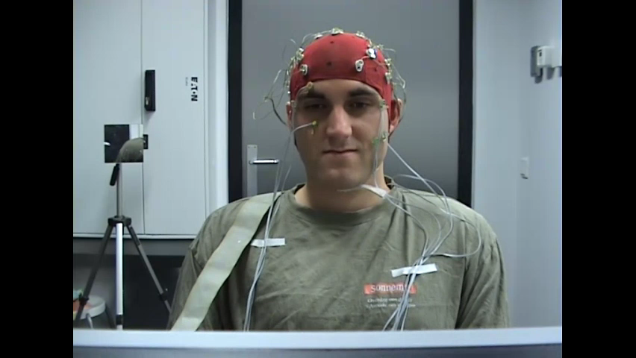
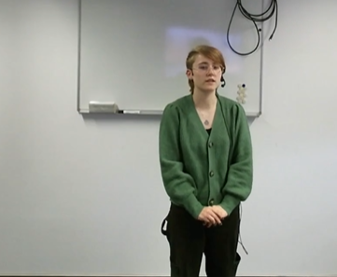
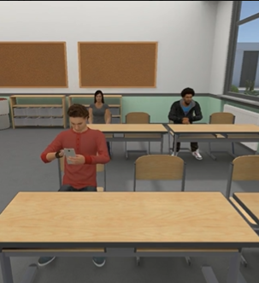
Motivation for thesis Implementation Study Results Conclusion
Datasets Architecture Video Audio Fusion
DEAP Dataset
MITHOS Dataset
Participants : 18
Videos per Participant : 40
Data duration : 70 hrs
Modalities considered : Video
Participants : 28
Videos per Participant : 6
Data duration : 1.42 hrs
Modalities considered : Video, Audio
Sander Koelstra, Christian Muehl, DEAP: A Database for Emotion Analysis using Physiological Signals , 2012
Notes:
Datasets- AffectNet, EmoReact, SEWA, etc. (No PAD labels, different definition of D)
Mithos- Student/Teacher conflict resolution system.
Data augmentation- rotating images by small angles (e.g., ±10 degrees), performing vertical flips, etc.
Train/Test split : 3 participants/120 videos && 3 participants (18 videos)

Slide 8
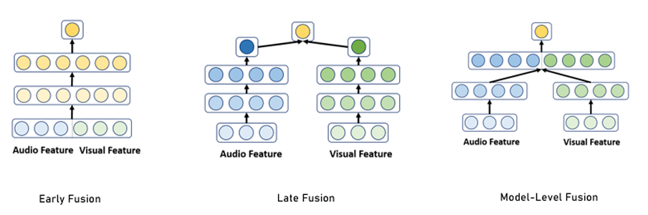
Motivation for thesis Implementation Study Results Conclusion
Datasets Architecture Video Audio Fusion
Audio
Video
Audio
Video
Audio
Video
Sander Koelstra, Christian Muehl, DEAP: A Database for Emotion Analysis using Physiological Signals , 2012
Notes:
How do we use our modalities.
Early fusion probs – not scalable, have to change architecture everytime modality is added
Late Fusion -

Slide 9


Motivation for thesis Implementation Study Results Conclusion
Datasets Architecture Video Audio Fusion
Video Model for video feature extraction
Video Input
Multimodal Fusion Model
len x 224 x 224 x 3
768x32
PAD
Output
Audio Model for audio feature extraction
512x32
Audio Input
len x 16000
Notes:
Makes input to fusion model smaller. These features are good representations of the input, making them more context aware which focusing only on relevant information

Slide 10
Motivation for thesis Implementation Study Results Conclusion
Datasets Architecture Video Audio Fusion
Video Input
Video Feature Extractor
Fusion Module
Output
Audio Input
Audio Feature Extractor
Notes:
Architecture in short for further reference

Slide 11
Motivation for thesis Implementation Study Results Conclusion
Datasets Architecture Video Audio Fusion
PAD
Pleasure Arousal Dominance
∈ [1,9]
Video Input
Video Feature Extractor
Mean Absolute Error (MAE)
2) Range-2 accuracy
3) Pearson’s Correlation Coefficient
4) Mean Square Error (MSE)
Fusion Module
Output
Audio Input
Audio Feature Extractor
Actual value
Predicted value
Range-2
MAE
I I I I I I I I I
1 2 3 4 5 6 7 8 9
Notes:
Range 2 accuracy - +-2 of actual value
Gives a good estimate across various situations
Shows that predicted value is closer to actual value

Slide 12
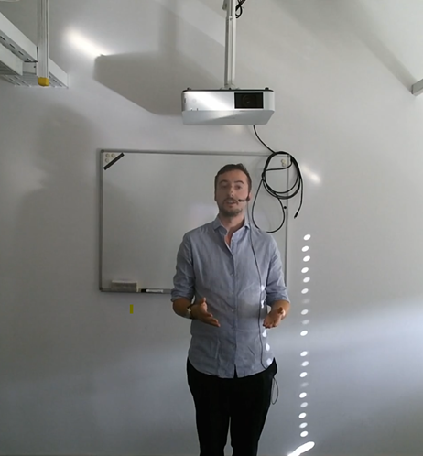
Motivation for thesis Implementation Study Results Conclusion
Datasets Architecture Video Audio Fusion
Video Segmentation
Video Stream
Video Feature Extractor
Video Input
Cue 2
Cue 3
Fusion Module
Case 1: Sliding window frame
-N seconds
+N seconds
PAD Output
Audio Feature Extractor
Case 2: From VSM and SSC logs
Cue 2 frame time segment
Audio Input
MITHOS
Cue 3 frame time segment
Case 3: From VSM and SSC logs without overlaps
Cue 2 frame time segment
Cue 3 frame time segment
DEAP
1 video 1 input
Whole video is one input
G Chen, D Clarke, Multi-modality gesture detection and recognition with un-supervision, randomization and discrimination, 2014
Notes:
Sliding Window frame: does not align well with emotional changes.

Slide 13


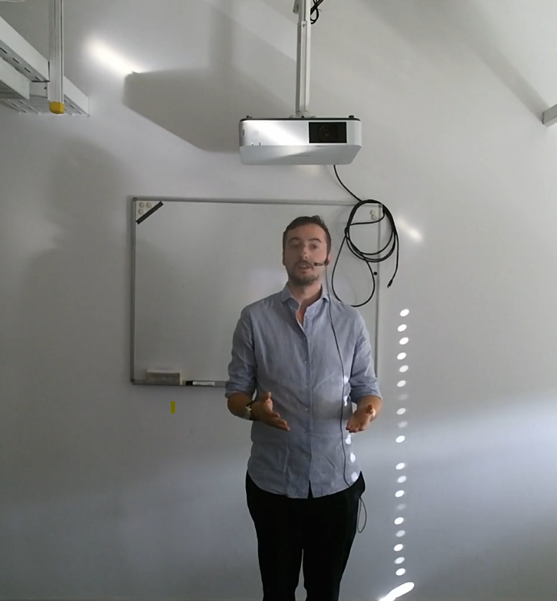

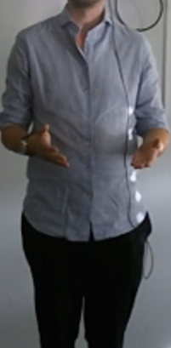
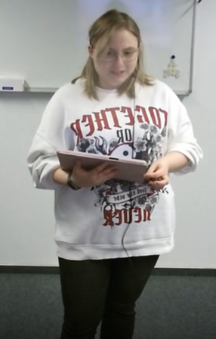
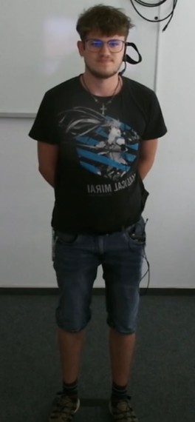
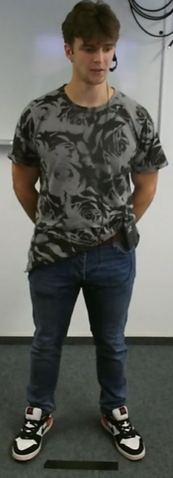
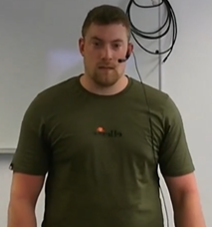
Motivation for thesis Implementation Study Results Conclusion
Datasets Architecture Video Audio Fusion
Inputs per frame
Video Feature Extractor
Video Input
Fusion Module
PAD Output
Audio Feature Extractor
Audio Input
Audio Input
[1]
[2]
[1] Annika Bätz, Gunjan Mishra Facial Landmarks Detection : A Brief Chronological Survey & Practical Implementation, 2021
[2] Jong-Wook Kim, Jin-Young Choi Human Pose Estimation Using MediaPipe Pose and Optimization Method Based on a Humanoid Model, 2023
Notes:
Data preprocessing before we input to the video model.

Slide 14
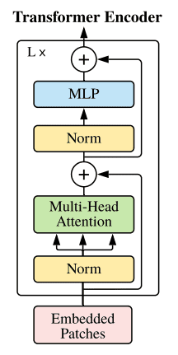
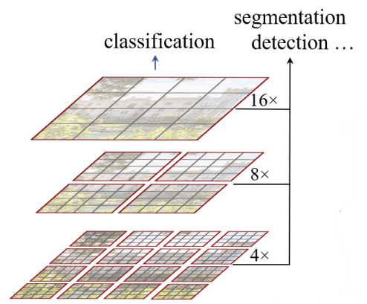
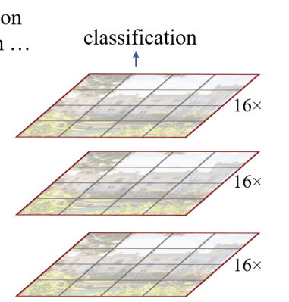

Motivation for thesis Implementation Study Results Conclusion
Datasets Architecture Video Audio Fusion
Video Model Selection
Transformer-based ^{[2]}
CNN-based ^{[1]}
Video Feature Extractor
Video Input
Fusion Module
PAD Output
Audio Feature Extractor
Swin Transformer ^{[4]}
Vision Transformer ^{[3]}
Audio Input
[1]Keiron O’Shea An Introduction to Convolutional Neural Networks, 2015
[2] Ashish Vaswani, et al. Attention is All You Need, 2017
[3] Anurag Arnab, et al. Vivit: A video vision transformer 2021
[4] Ze Liu, et al. Video swin transformer. 2022
Notes:
Attention- focuses on the most relevant parts of input data
Multihead attention- relevant info from spacial and temporal cues enabling parallel processing
LN- efficient learning across layers by stabilizing the flow and keeping the network balanced
Residual connections- retains original information while integrating new patterns learned in each layer

Slide 15
Motivation for thesis Implementation Study Results Conclusion
Datasets Architecture Video Audio Fusion
Transfer Learning
Pre-Trained Model
Large Scale Video Datasets
Reg
Output
Video Feature Extractor
Video Input
Context Aware Features
Fusion Module
PAD Output
DEAP Dataset
Reg
Output
Audio Feature Extractor
Classification Head
Regression Layer
Audio Input
PAD
Action Recognition, Video Classification, etc.
MITHOS Dataset
Reg
Output
Anurag Arnab, et al. Vivit: A video vision transformer 2021
Fuzhen Zhuang, Zhiyuan Qi A comprehensive survey on transfer learning 2020
Notes:
Layers of the model already have learned high-level patterns from videos(colour, edges, shapes) and we need to tweak the latter layers only for recognising patterns specific to our use-case.

Slide 16
Motivation for thesis Implementation Study Results Conclusion
Datasets Architecture Video Audio Fusion
Video Model Results
Ablation Study
Model | Dimension | Train MAE | Train PCC | Test MAE | Test PCC
DEAP | P | 2.6 | 0.6 | 2.1 | 0
 | A | 2.65 | 0.4 | 1.6 | 0.2
 | D | 1.9 | 0.6 | 1.8 | 0.2
 | Overall | 2.4 | 0.5 | 1.8 | 0.1
MITHOS | P | 3 | 0.51 | 1.722 | 0
 | A | 3.127 | 0.348 | 1.344 | 0.166
 | D | 2.337 | 0.492 | 1.53 | 0.1
 | Overall | 2.8 | 0.5 | 1.5 | 0.1
DEAP + MITHOS | P | 1 | 0.6 | 1.3 | 0.4
 | A | 0.9 | 0.9 | 0.9 | 0.12
 | D | 1 | 0.8 | 1.1 | 0.45
 | Overall | 1.0 | 0.8 | 1.1 | 0.3
Video Feature Extractor
Video Input
Fusion Module
PAD Output
Audio Feature Extractor
Audio Input
Notes:
Results showing Transfer Learning works

Slide 17
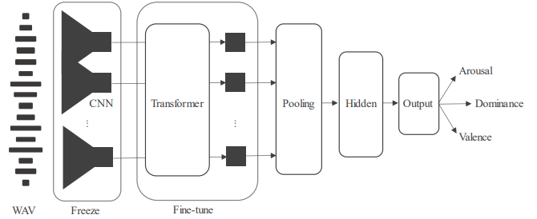

Motivation for thesis Implementation Study Results Conclusion
Datasets Architecture Video Audio Fusion
Audio Models
Transformer-based Wav2Vec2 ^{[1]}
CNN-based
Video Feature Extractor
Video Input
Fusion Module
PAD Output
Audio Feature Extractor
Audio Input
Audio Inputs
16K Hz Frequency
[1] Johannes Wagner, et al. Dawn of the transformer era in speech emotion recognition: closing the valence gap.
Notes:
Inputs are Wave files with 16KHz sample rate
Different model architectures experimented with

Slide 18
Motivation for thesis Implementation Study Results Conclusion
Datasets Architecture Video Audio Fusion
Audio Model Results
Audio Model Selection
Model | Dimension | Train MAE | Train PCC | Test MAE | Test PCC
3DCNN | Pleasure | 0.8 | 0.6 | 1.9 | -0.08
 | Arousal | 0.6 | 0.7 | 1.8 | 0.1
 | Dominance | 1.1 | 0.5 | 2.1 | 0.2
 | Overall | 0.8 | 0.6 | 1.9 | 0.1
Wav2Vec without fine-tuning | Pleasure | - | - | 1.6 | -0.5
 | Arousal | - | - | 1.5 | 0.4
 | Dominance | - | - | 1.5 | 0.4
 | Overall | - | - | 1.3 | 0.1
Wav2Vec with fine-tuning | Pleasure | 0.4 | 0.7 | 1.4 | -0.1
 | Arousal | 0.2 | 0.8 | 0.9 | 0.4
 | Dominance | 0.3 | 0.7 | 1.4 | 0.2
 | Overall | 0.3 | 0.7 | 1.2 | 0.2
Video Feature Extractor
Video Input
Fusion Module
PAD Output
Audio Feature Extractor
Audio Input
Notes:
Results showing Transfer Learning works

Slide 19
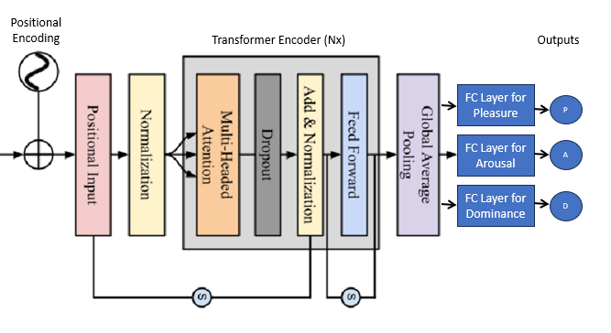
Motivation for thesis Implementation Study Results Conclusion
Datasets Architecture Video Audio Fusion
Fusion Models
Video Features
Cross Modal Attention
Video Features
RNN LSTM
Video Feature Extractor
Audio Features
Video Input
Audio Features
Fusion Module
PAD Output
Audio Feature Extractor
Audio Input
Simple Transformer Architecture
Video Features
Audio Features
Notes:
CrossModalAtt - assigns attention weights to elements in one modality based on their relationship to elements in the other modality. E.g. model learns how Lip movements relate to speech sounds. Fails to learn temporal features.
RNN-LSTM – used for learning special and temporal patterns but become very compute heavy especially for parallel processing and handling long-range dependencies.
Transformers – multihead att for parallel processing with benefits of attention mechanisms, along with FFN and LN.

Slide 20
Motivation for thesis Implementation Study Results Conclusion
Datasets Architecture Video Audio Fusion
Fusion Model Results
Fusion Model Selection
Model | Dimension | Train MAE | Train PCC | Test MAE | Test PCC
Early Fusion Model | Pleasure | 1.3 | 0.4 | 1.8 | 0.2
 | Arousal | 1.1 | 0.2 | 1.2 | -0.3
 | Dominance | 1.2 | 0.1 | 1.7 | 0.1
 | Overall | 1.2 | 0.2 | 1.6 | 0.0
Cross Modal Attention | Pleasure | 1.1 | 0.4 | 1.1 | 0.2
 | Arousal | 1.3 | 0.1 | 0.6 | 0
 | Dominance | 1.4 | 0.1 | 1.5 | 0.1
 | Overall | 1.3 | 0.2 | 1.1 | 0.1
RNN-LSTM | Pleasure | 1.6 | 0.06 | 1.2 | 0.2
 | Arousal | 1.3 | 0.2 | 0.9 | 0
 | Dominance | 1.4 | 0 | 1.5 | 0
 | Overall | 1.4 | 0.09 | 1.2 | 0.07
Transformer | Pleasure | 0.9 | 0.3 | 1 | 0.3
 | Arousal | 0.7 | 0.5 | 0.8 | 0.5
 | Dominance | 1.1 | 0.4 | 1.3 | 0.25
 | Overall | 0.9 | 0.4 | 1.0 | 0.4
Video Feature Extractor
Video Input
Fusion Module
PAD Output
Audio Feature Extractor
Audio Input
Notes:
Proves that Fusion is better

Slide 21
Motivation for thesis Implementation Study Results Conclusion
Model Comparisons Modalities Impact Interdependencies
Overall Accuracy
Model | Dimension | Test MAE | Test PCC | Test Range 2 accuracy | Test Class Accuracy
Video Model (ViViT) | Pleasure | 1.3 | 0.4 | 68 | 60
 | Arousal | 0.9 | 0.12 | 78 | 63
 | Dominance | 1.1 | 0.45 | 70 | 57
 | Overall | 1.1 | 0.3 | 72 | 60
Audio Model (Wav2Vec2) | Pleasure | 1.4 | -0.1 | 80 | 45
 | Arousal | 0.9 | 0.4 | 82 | 50
 | Dominance | 1.4 | 0.2 | 71 | 50
 | Overall | 1.2 | 0.2 | 78 | 48.3
Fusion Model (Transformer) | Pleasure | 1 | 0.3 | 73 | 64
 | Arousal | 0.8 | 0.5 | 95 | 92
 | Dominance | 1.3 | 0.25 | 75 | 65
 | Overall | 1.0 | 0.4 | 81.0 | 73.7
Attention model perform better in all cases
Fusion Models takes the best of both audio and video and generate prediction
Predicted outputs within smaller range of actual outputs
Better Range-2 accuracies in Fusion
Notes:
Change Range 2 accuracies to percentage

Slide 22
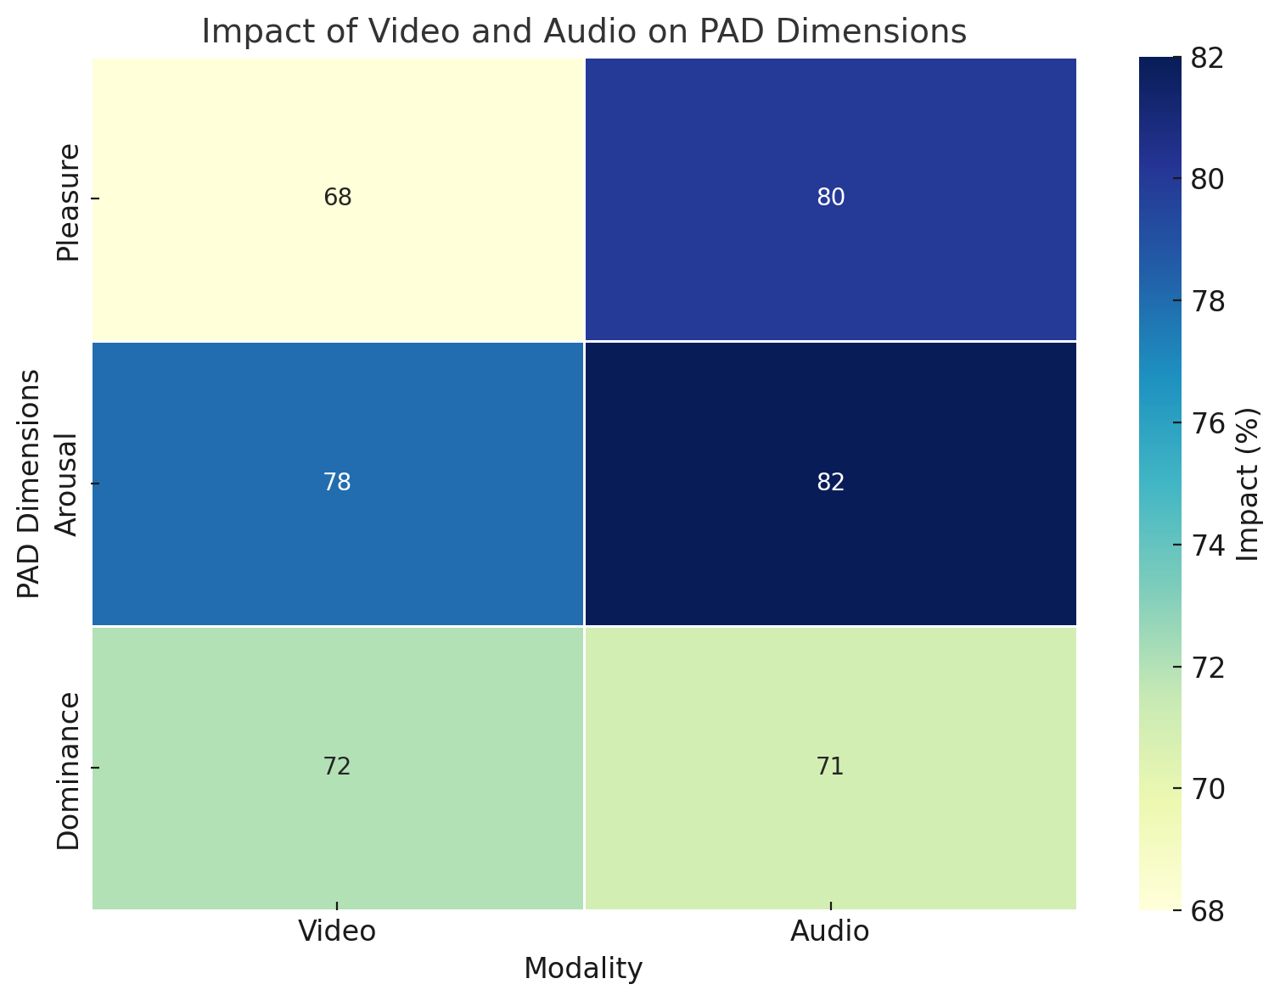
Motivation for thesis Implementation Study Results Conclusion
Model Comparisons Modalities Impact Interdependencies
Notes:
Audio modality plays a larger role in predicting Pleasure and Arousal, likely due to vocal cues like tone, pitch, and intensity, which convey emotions such as excitement or calmness.
Video modality is more influential in predicting Dominance, as visual, non-verbal cues—such as facial expressions or gestures strongly indicate confidence and control

Slide 23
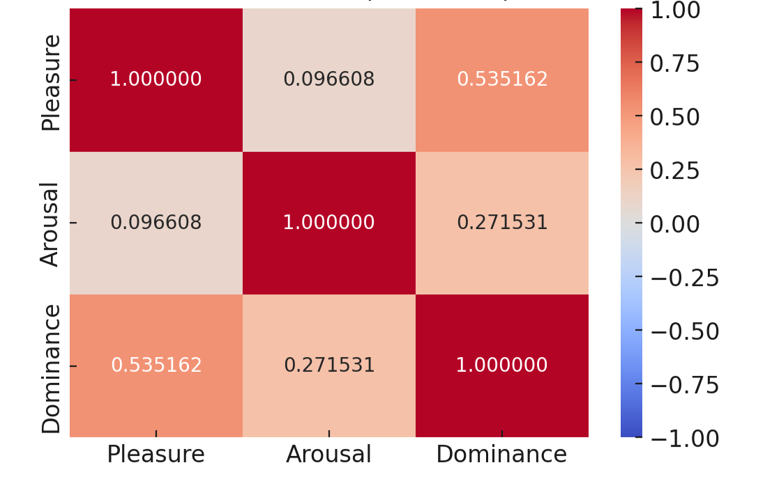
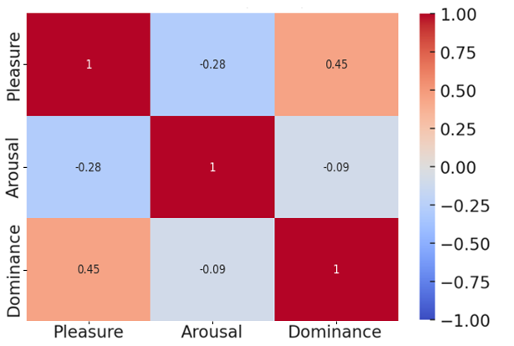
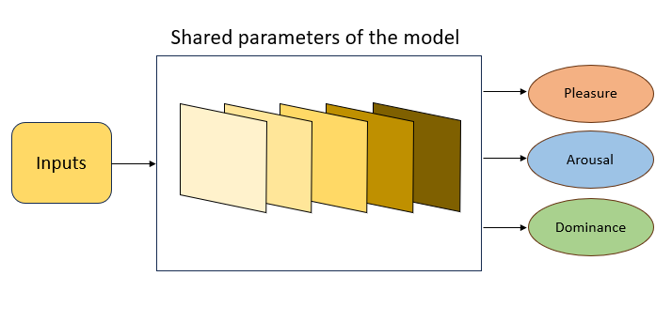
Motivation for thesis Implementation Study Results Conclusion
Model Comparisons Modalities Impact Interdependencies
DEAP data confusion matrix
MITHOS data confusion matrix
Notes:
Results

Slide 24
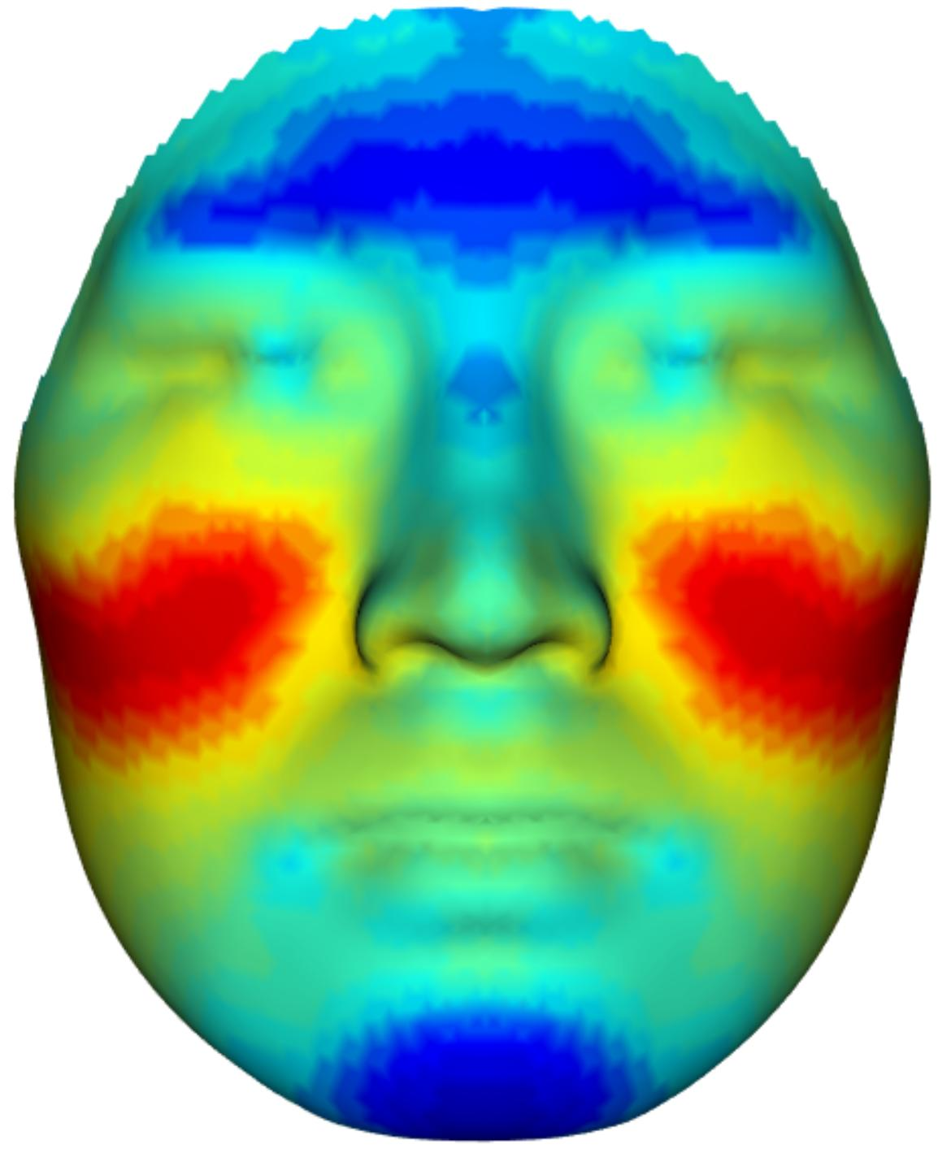
Motivation for thesis Implementation Study Results Conclusion
Conclusions
Future Work
PAD values predicted with non-intrusive modalities using attention-based mechanisms.
Model can be extended to incorporate the “Text” modality
Fusing both modalities gives best of both worlds.
Transfer learning has proved to work well, this model can be used for other affect analysis
Audio has more impact on predicting Pleasure and Arousal and Video has more impact on predicting Dominance
Inferences can be used in virtual agents to enhance the conversational experience in a human-virtual agent scenario
Transfer Learning is useful
Heatmap refernce
Notes:
Further analysis on which parts of the audio-video signals contribute to the prediction can be analyzed and then replicated in a virtual agent for better responses.

Slide 25
Thank You

Slide 26
Motivation for thesis Implementation Study Results Future Work
Model Comparisons Conclusions
PAD values are predicted instead of just PA
Multiple non-intrusive modalities are used for prediction
Attention based mechanisms outperform other deep learning models
Transfer Learning is useful
Fusion performs better than individual Audio-Video models
Extracting features from individual audio-video models and passing to fusion performed better than early fusion
Fusion model takes the best of both audio and video even though audio and video models are trained on large amounts of data
PAD values possess interdependencies which are proved as one model performs better for all 3 models as compared to individual PAD models, except Arousal
Audio has more impact on predicting Pleasure and Arousal
Video has more impact on predicting Dominance

Slide 27
Motivation for thesis Implementation Study Results Future Work
Inferences can be used in virtual agents to enhance the conversational experience in a human-virtual agent scenario
Further analysis on which parts of the audio-video signals contribute to the prediction can be analyzed and then replicated in a virtual agent for better responses.
Model can be extended to incorporate the “Text” modality
Transfer learning has proved to work well, this model can be used for other affect analysis

